Slide 1
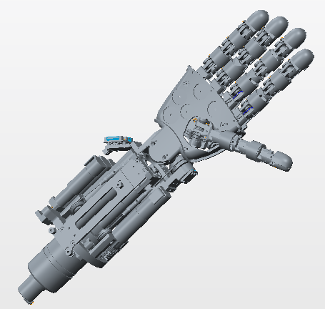
iCub3 Forearm joints specs
Rev. 1
22/02/2016

Slide 2
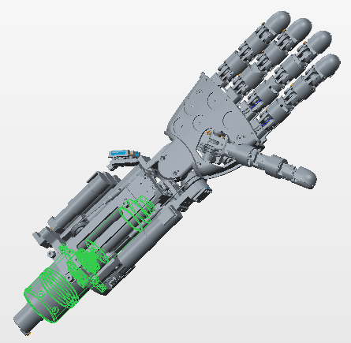
JOINTS 0– Forearm pronosupination
-Motor type: DC
-Motor encoder: 512 ppr
-Harmonic drive: 1/100
-No encoder at the joint
-HW limits roll (±90°)

Slide 3
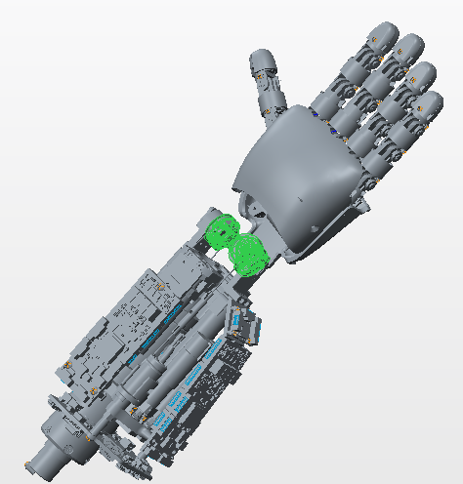
Wrist yaw & pitch – coupled joints
-Motor type: DC
-Motor encoder: 400 ppr
-Integrated gearbox 1/159
-Cables’pulleys reduction 14/ 18.8
- AEA at both joints
-HW limits ±45°

Slide 4
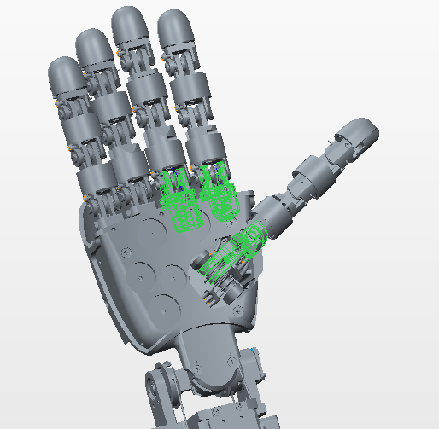
Thumb, index and middlef. proximals
-Motor type: DC
-Motor encoder: 10 ppr
-Integrated gearbox 1/256
-Pulleys reduction n.a.
- Hall effect sensor at the joint

Slide 5
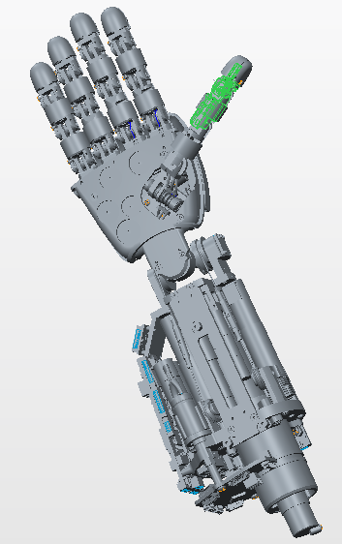
Thumb distals - 2 joints 1 motor
-Motor type: DC
-Motor encoder: 10 ppr
-Integrated gearbox 1/256
-Pulleys reduction n.a.
- Hall effect sensor at the joints

Slide 6
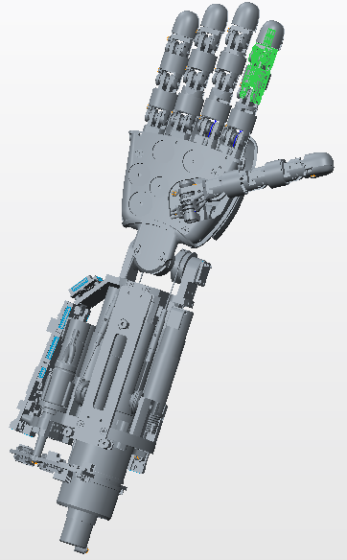
Index distals - 2 joints 1 motor
-Motor type: DC
-Motor encoder: 10 ppr
-Integrated gearbox 1/256
-Pulleys reduction n.a.
- Hall effect sensor at the joints

Slide 7
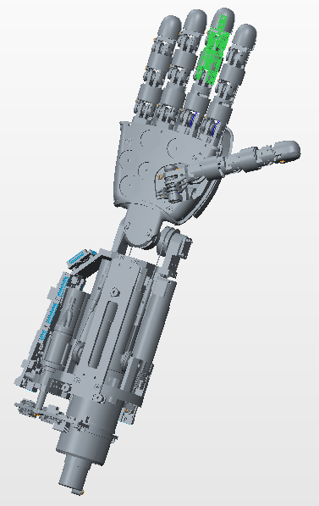
Middlefing. distals - 2 joints 1 motor
-Motor type: DC
-Motor encoder: 10 ppr
-Integrated gearbox 1/256
-Pulleys reduction n.a.
- Hall effect sensor at the joints

Slide 8
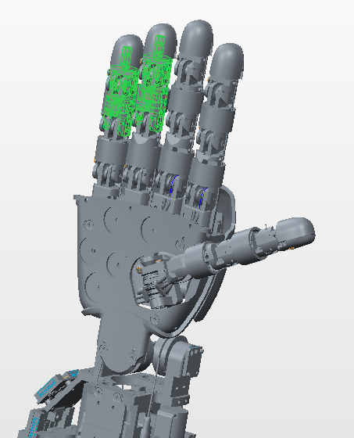
Ring and pinky distals - 4 joints 1 motor
-Motor type: DC
-Motor encoder: 10 ppr
-Integrated gearbox 1/256
-Pulleys reduction n.a.
- Hall effect sensor at the joints

Slide 9
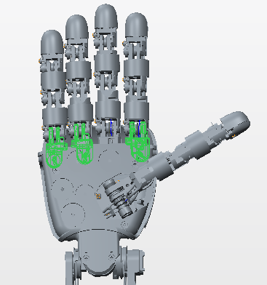
Fingers abduction
-Motor type: DC
-Motor encoder: no
-Integrated gearbox 1/256
-Pulleys reduction n.a.
- Hall effect sensor at the joint

Slide 10
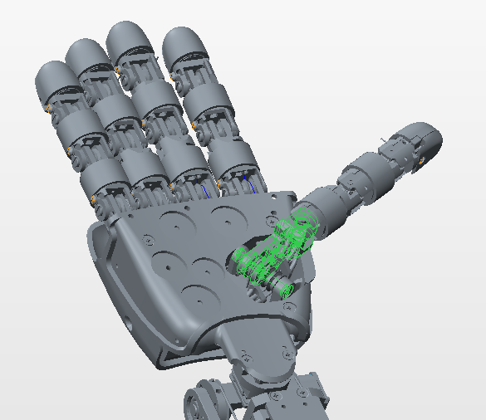
Thumb abduction
-Motor type: DC
-Motor encoder: no
-Integrated gearbox 1/256
-Pulleys reduction n.a.
-Hall effect sensor at the joint

